Slide 1
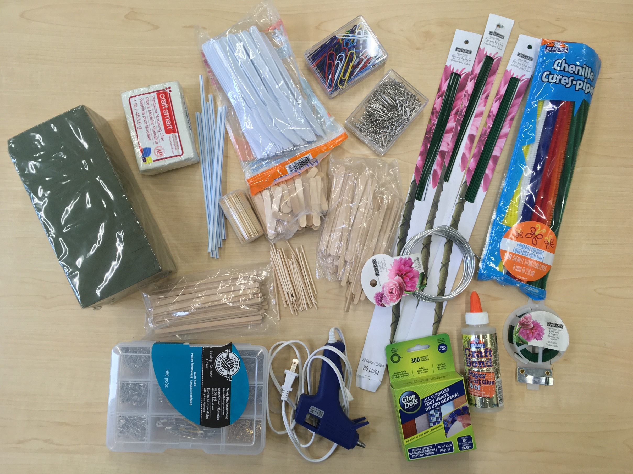
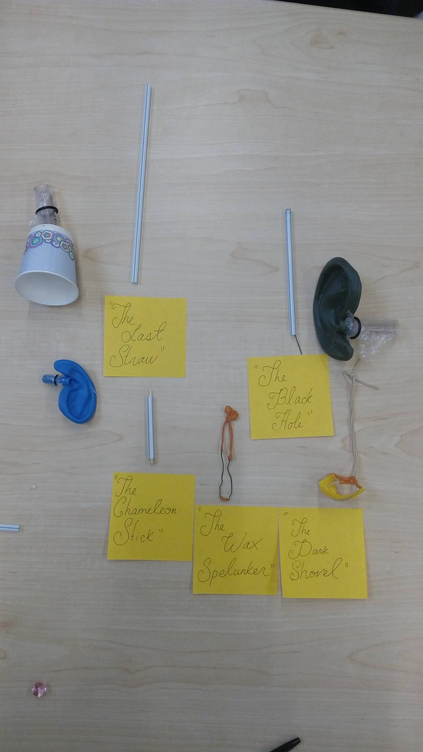
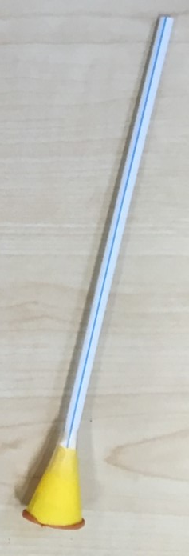
Design of Controllable Flexible Instruments to Facilitate Endoscopic Ear Surgery
Arushri Swarup^{1,2}, Adrian James²
1 Institute of Biomaterials and Biomedical Engineering, University of Toronto; 2 The Hospital for Sick Children, Toronto
Introduction
Part 1: Needs Analysis
Step 3: Prototype Creation
Transcanal endoscopic ear surgery (TEES) has undergone a surge of enthusiasm in recent years due to the benefits of minimally invasive surgery and clearer access to the tympanic membrane and recesses of the tympanic cavity. However, due to the one-handed surgical technique required for TEES, the surgery is challenging especially in children.
Otologic instruments, traditionally developed for two-handed surgery with operating microscopes, are not necessarily optimized for the TEES environment. To further advance TEES, it is important to thoroughly understand the limitations of current technology and instruments as well as the specific challenges that surgeons face.
Mixed Methods Survey
Materials
Objective
Example Prototypes
To design instruments to facilitate the challenges experienced during TEES.
Specific Aims
1. To determine the need for better instruments for specific TEES challenges
2. To design and prototype an instrument that will address the challenge(s) with greatest perceived need
Methods
Outcomes
Students were asked before and after the prototyping challenge: 1) To rate their knowledge of each brainstorming technique
Students felt their knowledge of the biological inspiration increased the most after the challenge was completed
2) To rank the brainstorming techniques in order of effectiveness
Students ranked the 6-3-5 method as the technique that yielded the best results after participating in the challenge
Conduct a Needs Analysis
Design and Prototype an instrument to address the challenges with the greatest need for better instruments
References
[1] Rohrbach B. "Kreativ nach Regeln–Methode 635, eine neue Technik zum Lösen von Problemen". Absatzwirtschaft 1969.
[2] "AskNature - Innovation Inspired by Nature" https://asknature.org/ (accessed April 21, 2017).
[3] Buzan T, Buzan B. The mind map book : unlock your creativity, boost your memory, change your life. Pearson/BBC Active; 2010.
[4] "Generating How Might We (HMW) Questions from Insights - Northwestern University | Coursera" https://www.coursera.org/learn/leadership-designinnovation/lecture/JMRYd/generating-how-might-wehmw-questions-from-insights (accessed April 27, 2017).
[5] “"Design Kit" http://www.designkit.org/methods/3 (accessed April 27, 2017).
Notes:
44" High x 44" Wide

